Slide 1



Predicting Severity of road accidents Elizabeth Kelley, Jack Wagner, Supriyo Ghosh, Tristan Freiberg
THE ERDŐS INSTITUTE
DATA SCIENCE BOOTCAMP, SPRING 2024
GitHub Repository

Slide 2
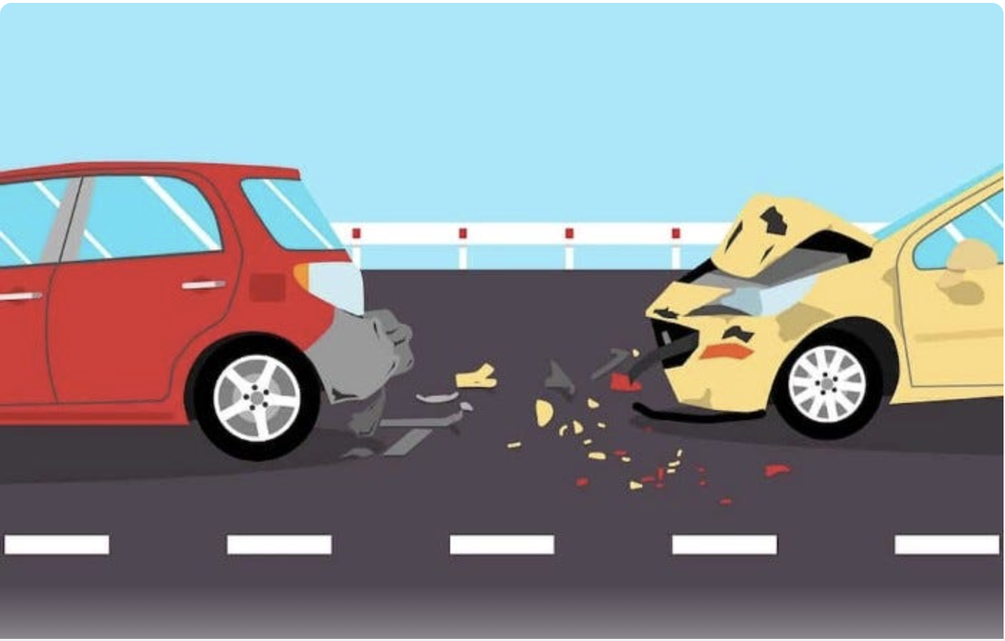
Introduction
Understanding and predicting traffic accident severity is crucial for improving emergency response protocols and urban planning strategies.
This project focused on analyzing data related to ~300,000 traffic accidents based on police reports filed in Montreal between 2011 and 2022.
The goal was to develop a model that could reliably predict the severity level of a traffic accident as belonging to one of three classes: material damage (no injuries), minor injuries, or serious/fatal injuries sustained by at least one person.
Providing 911 dispatchers or urban planners with predictive insights would facilitate better emergency response coordination, and infrastructure design that aligns with Vision Zero strategies, or generally reducing the frequency/severity of road accidents.

Slide 3
Data collection
We use the accident reports from QUEBEC AUTOMOBILE INSURANCE SOCIETY (SAAQ) for last 10 years.
Available features in the data can be grouped as: temporal (month, weekend/weekday, hour); environmental (e.g. weather, light conditions); road conditions and built-environment (speed limit, one-way versus two-way street, school zone/residential zone etc.); road users/vehicle (pedestrian, cyclist, motorcyclist, light truck, heavy vehicle); nature of the accident (single vehicle, collision with fixed object, animal, etc.).

Slide 4
Model selection
XGBoost was chosen as a classifier for our ternary classification problem, for the following reasons:
XGBoost is adept at handling imbalanced datasets, like ours: less than 1% of accidents are serious/fatal, and less than 20% are minor.
2. Speed and Efficiency: XGBoost is known for its speed and efficiency, making it feasible to train on large datasets with numerous features.
3. Handling Missing Values: XGBoost can handle missing values internally, reducing the preprocessing burden. Since our dataset contains missing values for most variables, this capability is advantageous.
4. Feature Interaction Handling: While it's challenging to discern which variables might interact in our dataset, XGBoost's ensemble nature inherently captures interactions between features. This can lead to more nuanced and accurate predictions compared to simpler models.

Slide 5
Model selection
Models used: Baseline, Logistic, Random Forest, SVM, XGBoost
Final model: XGBoost with upsampling
 | Predicted
Actual | 0 | 1 | 2 | Total
0 | 29598 | 7862 | 2092 | 39552
1 | 2555 | 4289 | 2744 | 9588
2 | 62 | 88 | 277 | 427
Total | 32215 | 12239 | 5113 | 49567
 | F2 score: 0.689

Slide 6
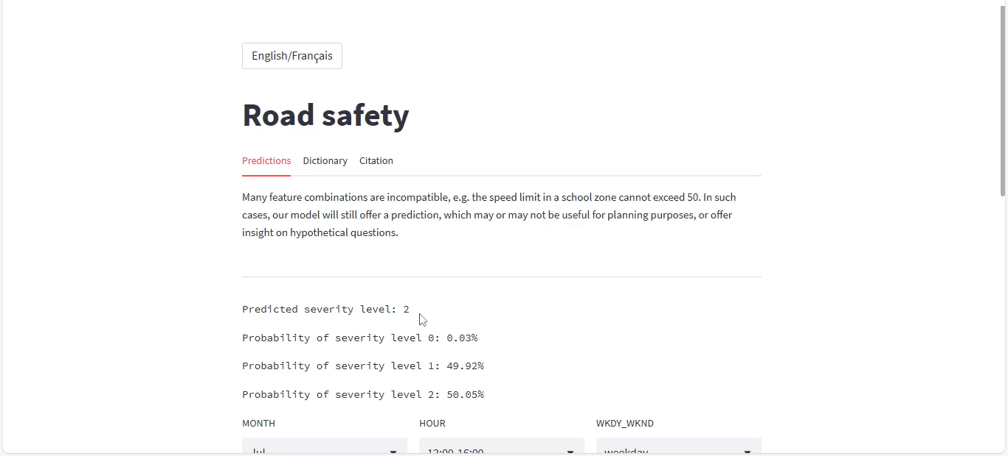
Streamlit application

Slide 7
Potential Future Directions
Test model on traffic data from different areas
Source traffic data with different variables to try to improve predictions
Create a tool for emergency vehicle dispatchers to allocate appropriate resources
Use model to make recommendations to city governments to improve areas with high accident severity

Slide 8
Potential Future Directions
We deployed the model in the form of a bilingual Streamlit app which could potentially be used to provide insight on questions such as: how would changing a two-way street to a one-way street affect severity level of accidents, if an accident occurs?
A much better-performing model would certainly be required for this to be a useful tool for 911 dispatchers. However, by collecting and exploiting certain other kinds of data associated with accidents, it may be feasible to obtain a sufficiently well-performing model for urban planning purposes. This is future work.

Slide 9
Acknowledgements
Our thanks to:
Dr. Adam Kawash, for his mentorship.
The Erdős Institute, for the opportunity and support!

